Slide 1
Bring in Benchmarking!!!

Slide 2
GLA Summit 2022

Slide 3

Our giants are female
Dilys Margaret Taylor
August 1945 → November 2022

Slide 4
About me

Slide 5


Starting backwards
https://github.com/neilpate/3DEngine
https://discord.gg/XAqnRNuXAD

Slide 6



















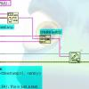











Thanks

Slide 7

Setting expectations

Slide 8
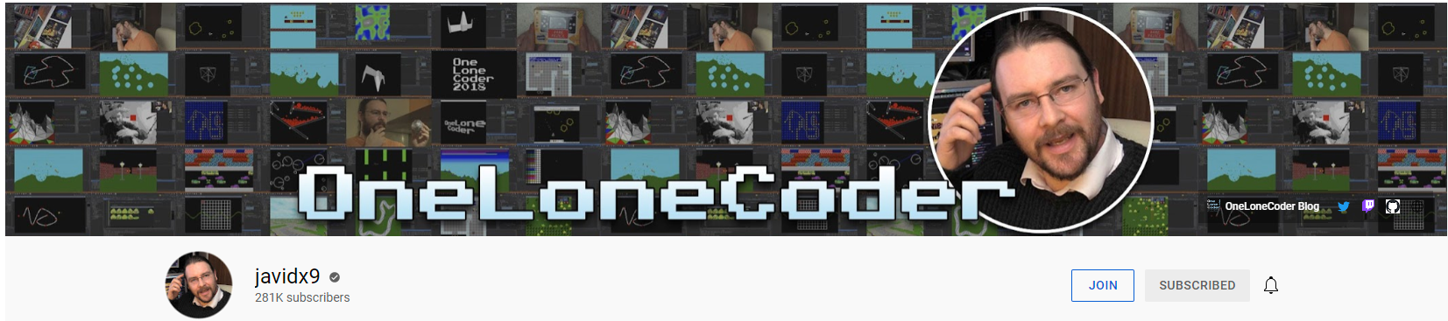
Thanks
Javidx9
itch.io

Slide 9
Start with the demo!

Slide 10
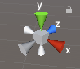
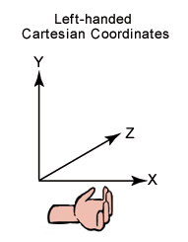
Coordinate systems

Slide 11
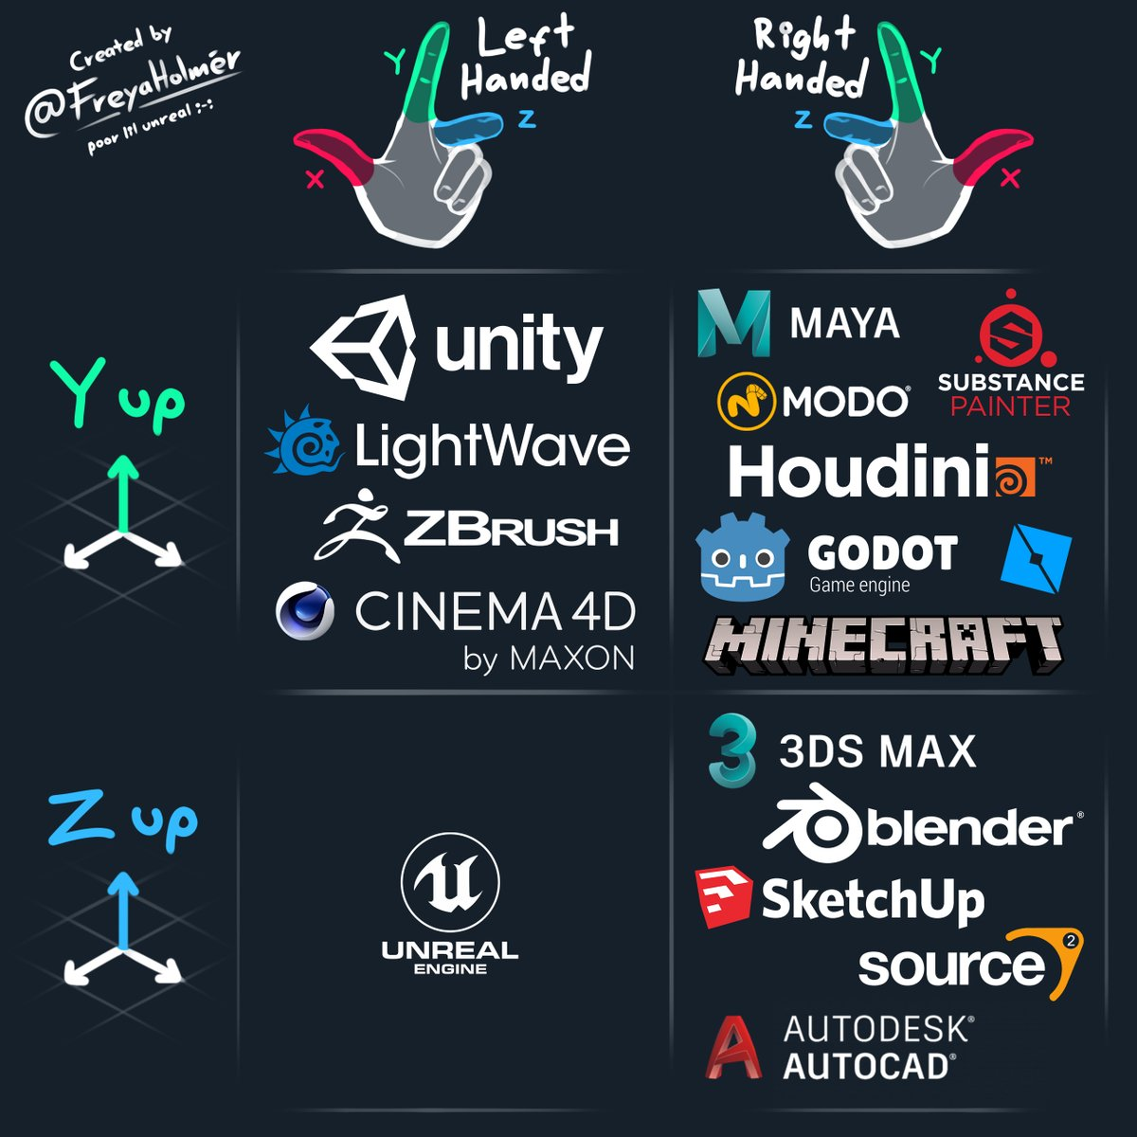

Slide 12
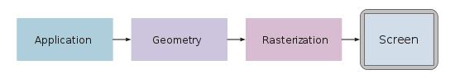
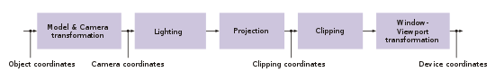
3D maths primer

Slide 13
Homogeneous coordinates
Homogeneous coordinates are ubiquitous in computer graphics because they allow common vector operations such as translation, rotation, scaling and perspective projection to be represented as a matrix by which the vector is multiplied. By the chain rule, any sequence of such operations can be multiplied out into a single matrix, allowing simple and efficient processing
4x4 matrices

Slide 14
Some interesting things
Frame rate independent animation

Slide 15
Talk about optimisation

Slide 16
But before we talk about optimising we need to measure.
→ Benchmarking

Slide 17
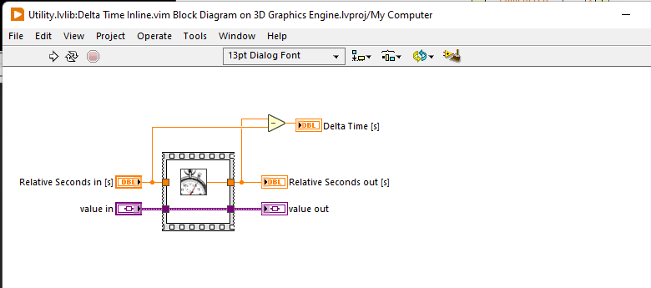
Simple benchmark framework
Deltatime VIM

Slide 18
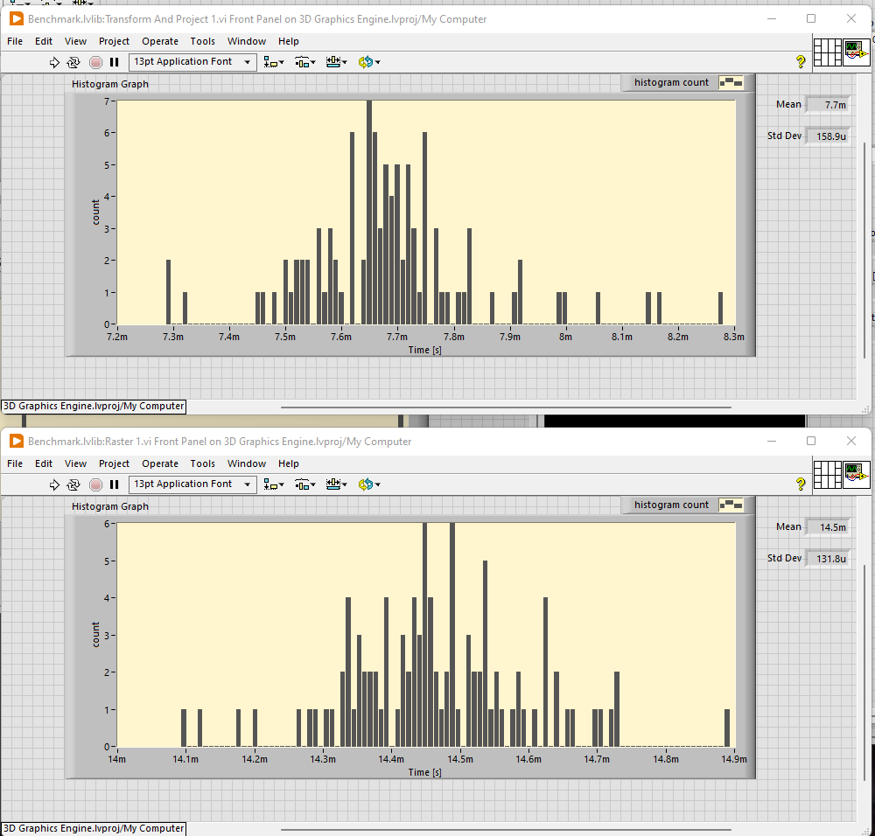
Using 2D Pixel
Marginally quicker!

Slide 19
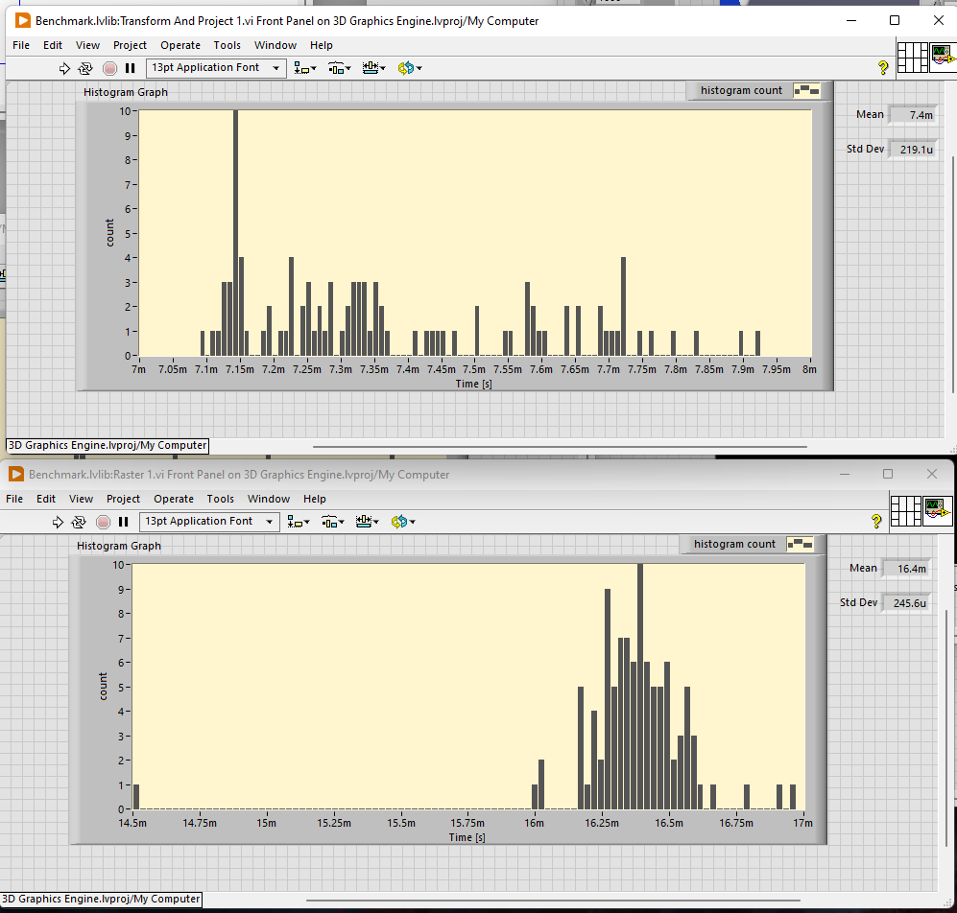
Using DVR

Slide 20
Profiling massively affects performance! (x10!!!)

Slide 21
Know when to stop benchmarking and optimising (have a goal in mind, for me it was > 60 FPS for the teapot)
But do identify the hot spots
Don’t bother optimising things that look slow but might not be called often enough to make a difference
Profiling will cause slowdowns! (Schroedingbug?)
Simple is better! Complicated scheme with DVRs and double buffering offered about the same performance but was much harder to work with. Trying to optimise out the pixel buffer was premature optimisation
Picture stuff is slow, can do some tricks like cache the rect
LabVIEW is weird, sometimes the code will suddenly run slowly for no apparent reason, restarting LabVIEW will fix it!

Slide 22
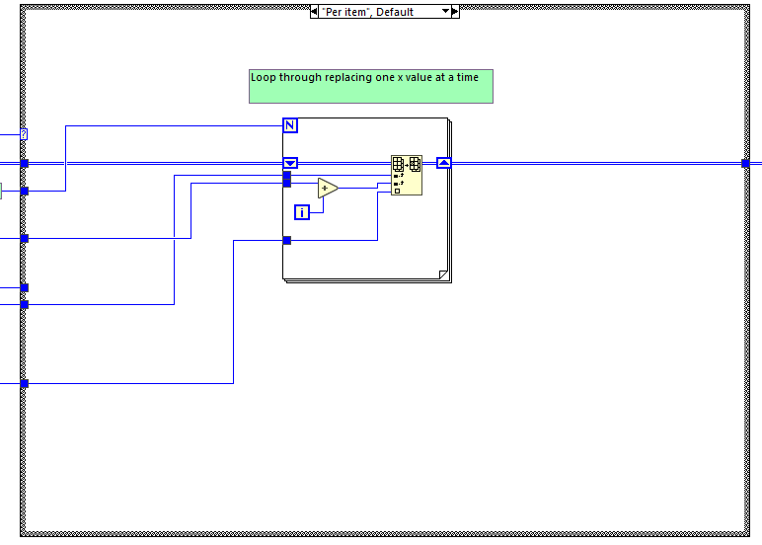
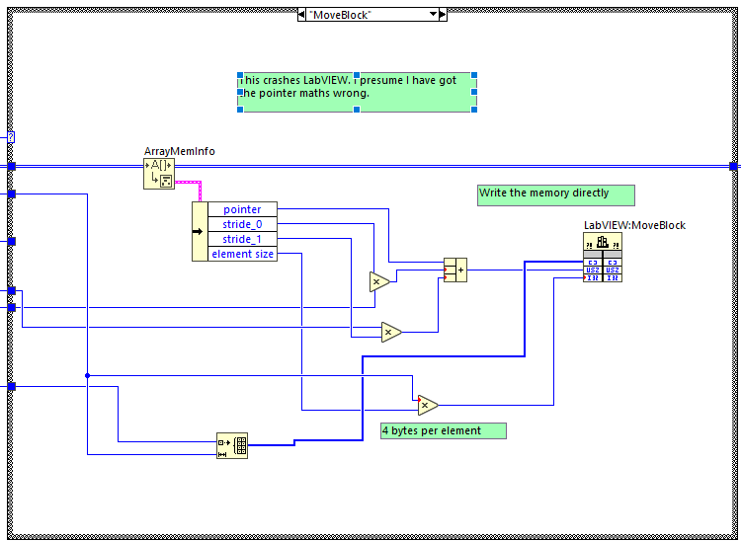
Naïve implementation is actually quickest with real world data
But clever low level technique is quickest with synthethic data.
Can draw the wrong conclusions from benchmarking and optimisation

Slide 23
Naïve implementation is actually quickest with real world data
But clever low level technique is quickest with synthethic data.
Can draw the wrong conclusions from benchmarking and optimisation

Slide 24
More to come?
Amnesia scene?
Texture mapping
Clipping
Collisions in 3D space?
https://youtu.be/sxW6CW0RWlg?t=492

